Slide 1
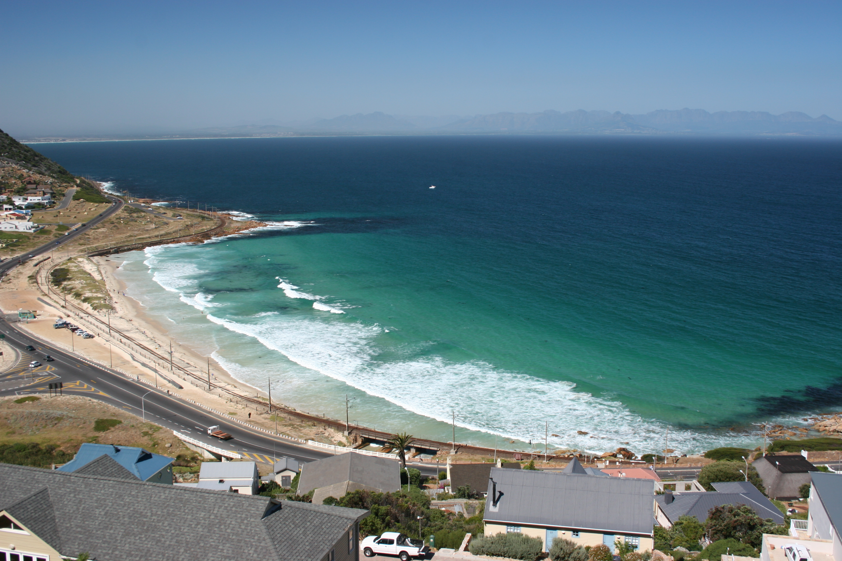
Wave and current measurements in support of coastal management plans in False Bay
Shark-Spotters 2006
Context: False Bay has a complex hydrodynamic environment, and the observations on the physical oceanography are sparse, both in time and space.
Outcome: Visualization and description of archival ADCP data and relate my findings to the known circulation features and modelling studies.
Notes:
Good morning everyone! My name is Ethan, and I am currently pursuing an honours degree in ocean and atmospheric science here at the department.
I am working on a project currently titled: Wave and current measurements in support of coastal management plans in False Bay.
Professor Marcello Vichi is my supervisor.
A little bit of context: False Bay has a complex hydrodynamic environment, and the observations on the physical oceanography are sparse, both in time and space.
The project is meant to support an ongoing research program on False Bay, dedicated to the design of future water lines for coastal management and planning.
That is the bigger picture, what I intent to produce is a visualization, description and way to access archival ADCP data, and relate my findings to the known circulation features and modelling studies.
For those of you that don’t know an ADCP (Acoustic Doppler Current Profiler) is a device that uses sound waves to measure the speed and direction of currents throughout the water column
Why am I doing this?
False Bay has played a large role in shaping my passion and interests.
This project is an opportunity to train while doing research, in an area outside of my comfort zone.
There is potential for aiding in larger projects by making archival data available using open source software.

Slide 2
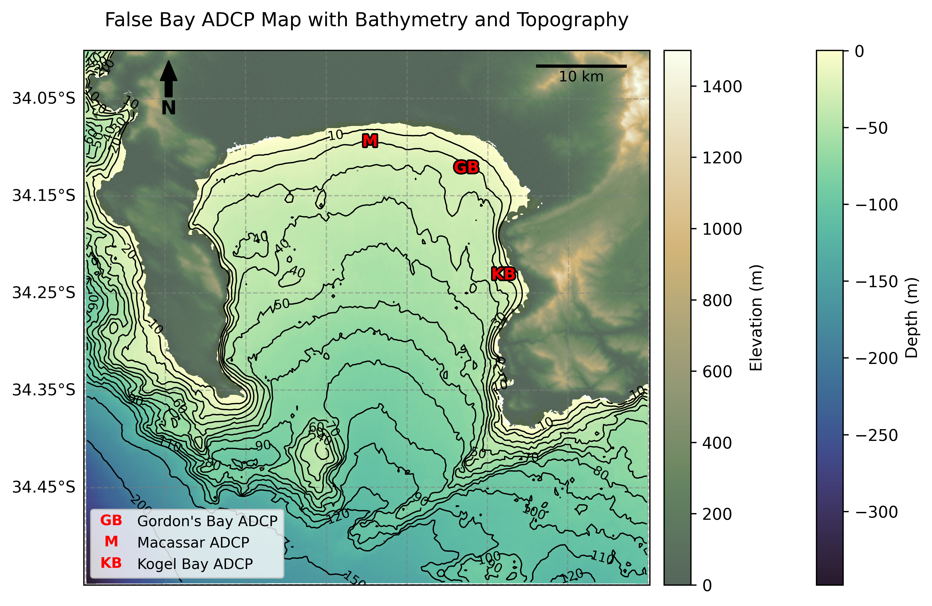
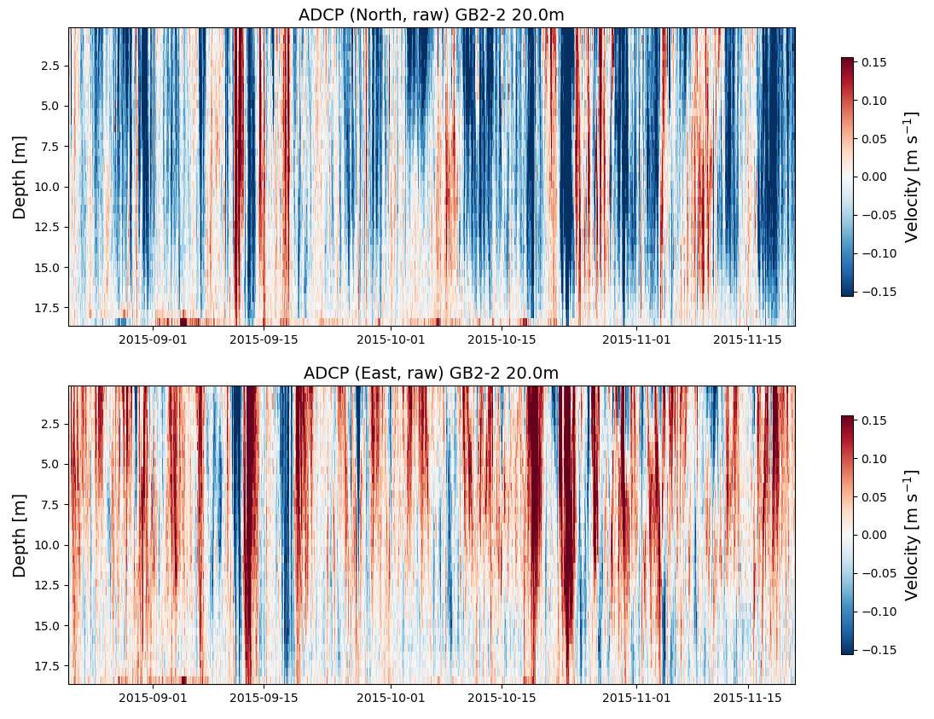

What are we doing?
Working on ADCP deployments between May 2015 and May 2017.
3-months duration, 6-minute ensemble intervals, and 1 m depth cells.
High resolution ADCP data used to look at the energy distribution of currents.
Allows us to look at high frequency variability in the currents at these locations.
Notes:
This is a simple map of False Bay, with three ADCP deployments shown as M for Macassar, GB for Gordon’s Bay and KB for Kogel Bay.
The Macassar instrument stopped recording shortly after deployment.
There is conflicting information regarding the location of some deployments, and I am going to be working on resolving those shortly.
What am I doing?
The deployments range between May 2015 and May 2017.
- Deployment Duration: 38 days
- Ensemble Interval: 6 minutes
- Depth Cell size: 1 m
The result is high resolution ADCP data, which can be used to produce spectral analysis of currents.
This is an example Hovmoller plot from a GB deployment. It has depth on the y-axis, time on the x-axis and the colours represent current velocity.
The top plot is the meridional component, so northward is positive and red. The bottom plot is the zonal component, and east is positive.
- This allows us to look at high frequency variability within the coastal circulation.
Why am I doing this?
False Bay has played a large role in shaping my passion and interests.
I know that the bay’s hydrodynamic environment is complicated.
This project is an opportunity to train while doing research, in an area outside of my comfort zone.
There is potential for aiding in making archival data available for larger projects.

Slide 3
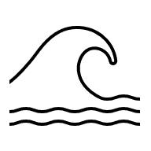
Thank you for listening!

